Slide 1
2017/2018 – Track Plots by Aircraft Type
GIRLI 3X

Slide 2
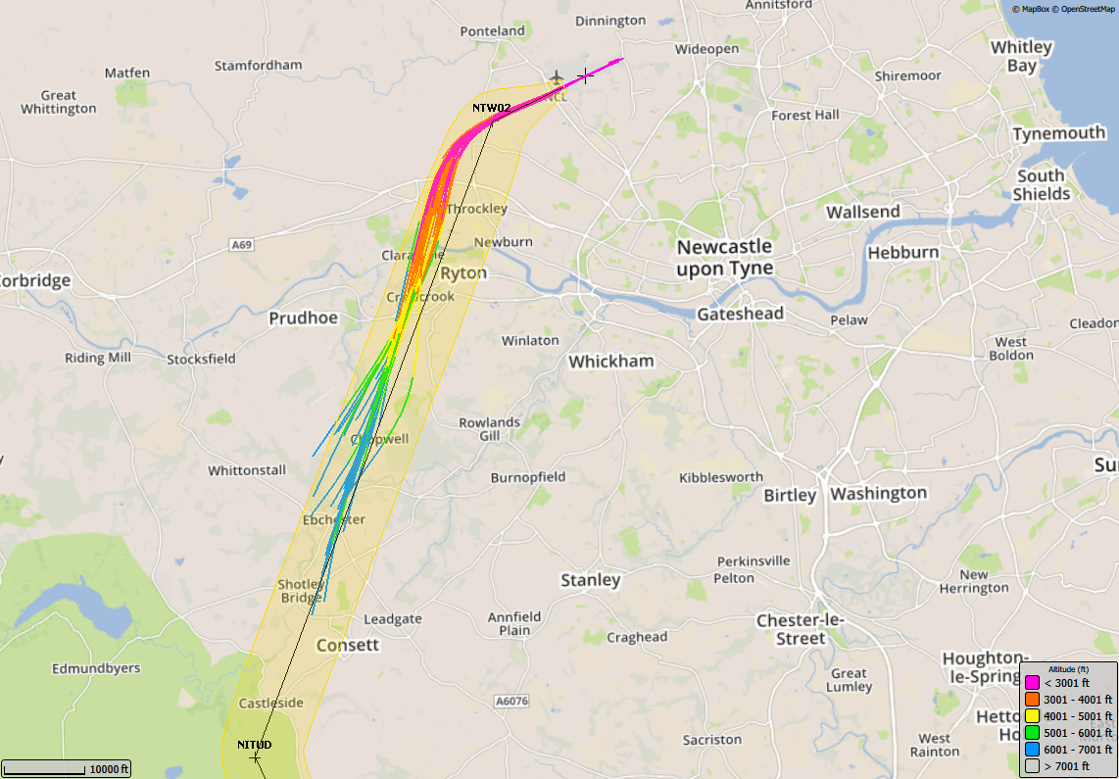
8/5/17 – 22/5/17, GIRLI 3X (60 TRACKS), Airbus 319

Slide 3
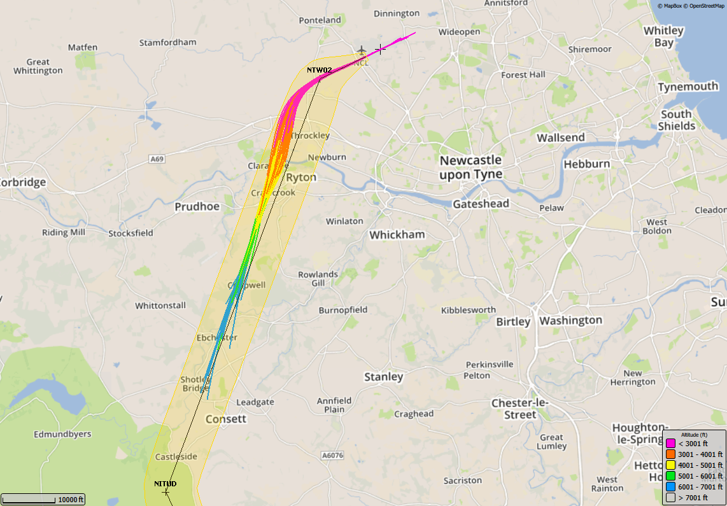
7/8/17 – 21/8/17, GIRLI 3X (87 TRACKS), Airbus 319

Slide 4
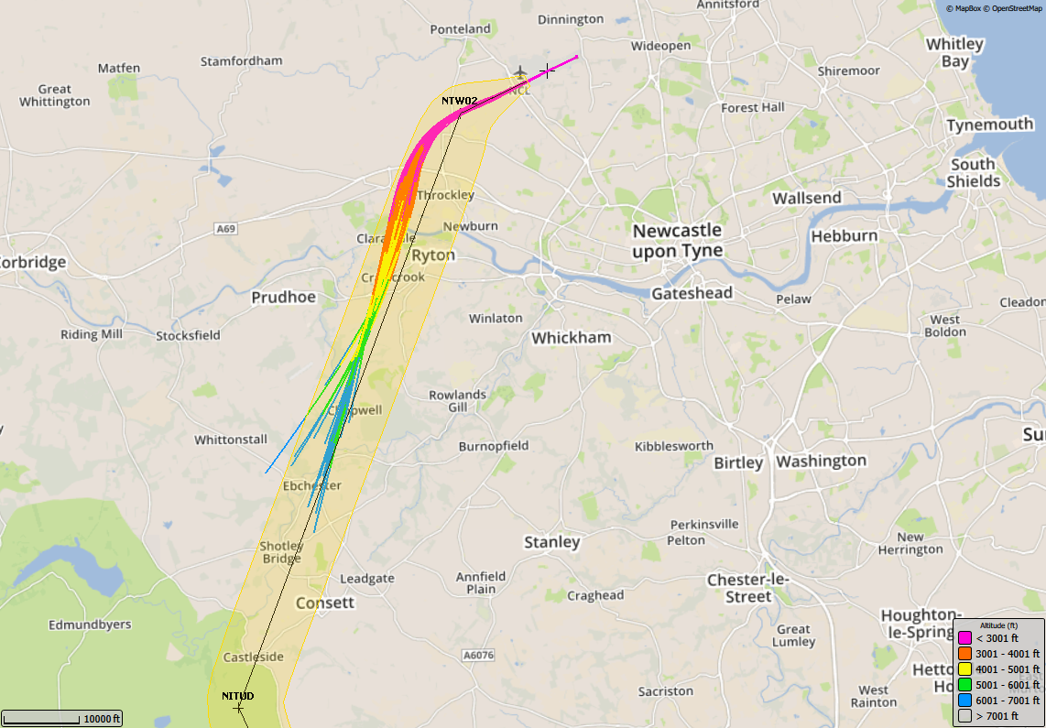
6/11/17 –20/11/17, GIRLI 3X (69 TRACKS), Airbus 319

Slide 5
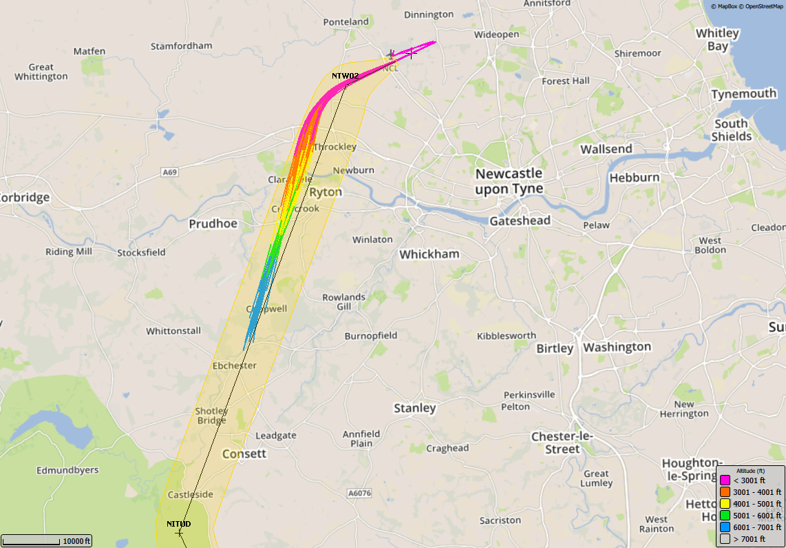
5/2/18 – 19/2/18, GIRLI 3X (107 TRACKS), Airbus 319

Slide 6
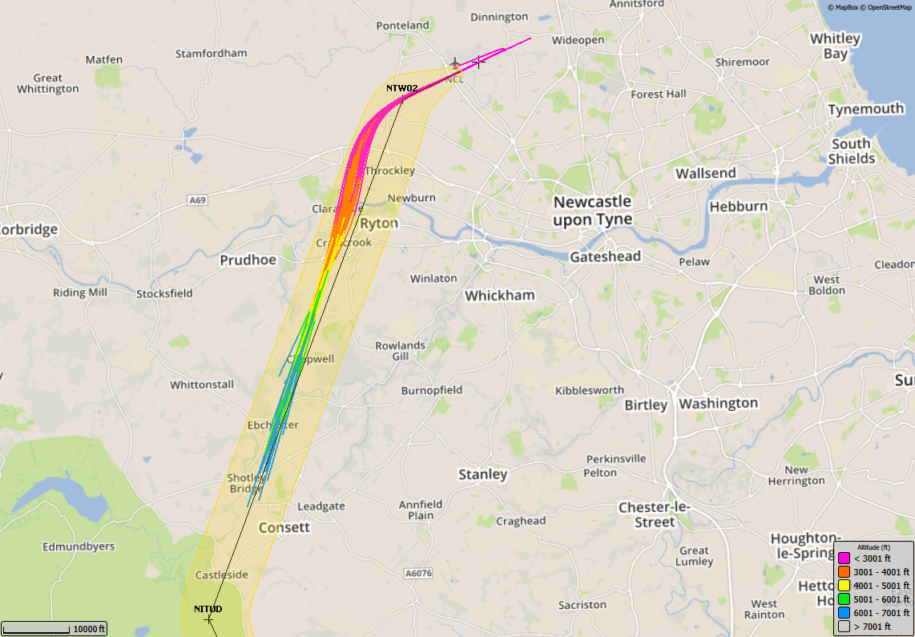
8/5/17 – 22/5/17, GIRLI 3X (42 TRACKS), Airbus 320

Slide 7
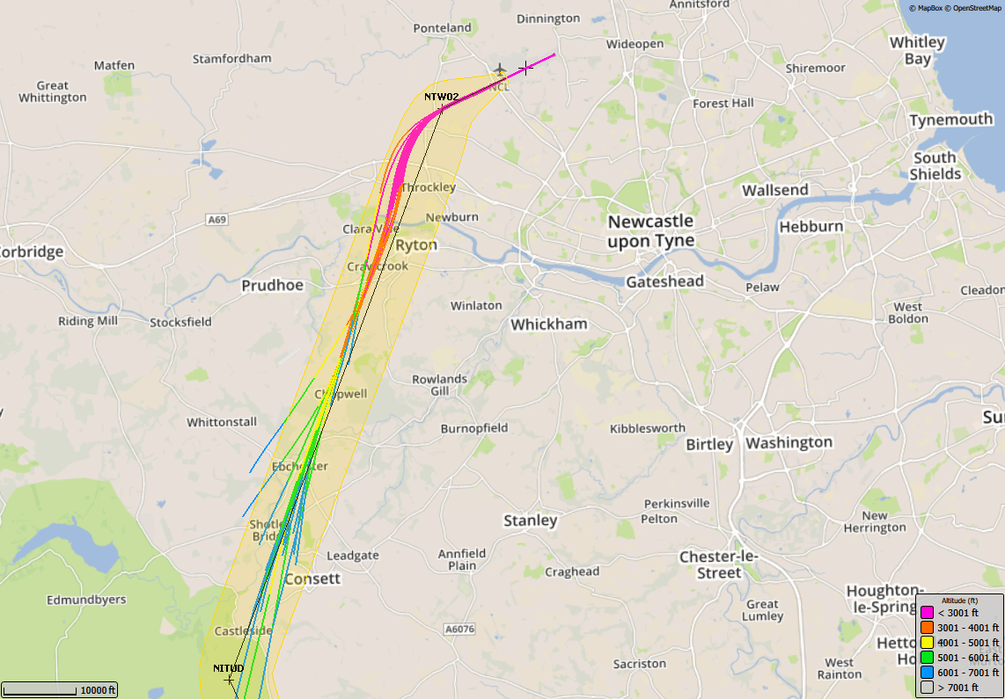
7/8/17 – 21/8/17, GIRLI 3X (30 TRACKS), Airbus 320

Slide 8
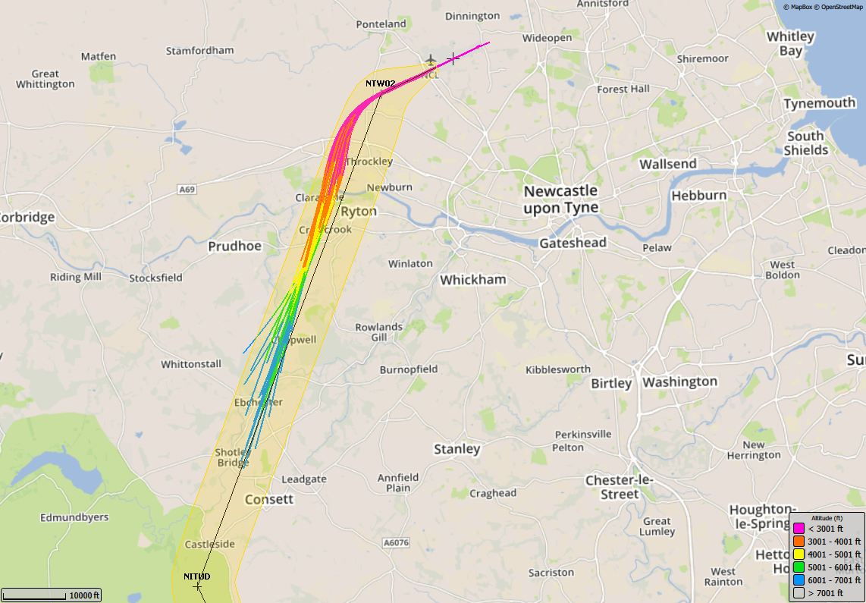
6/11/17 –20/11/17, GIRLI 3X (52 TRACKS), Airbus 320

Slide 9
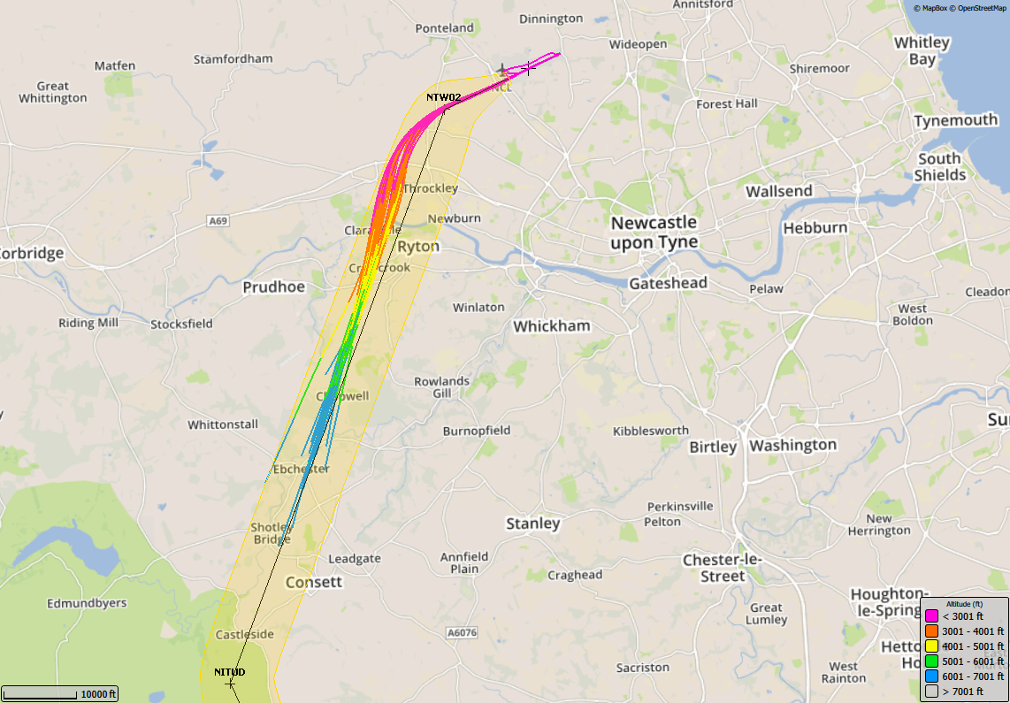
5/2/18 – 19/2/18, GIRLI 3X (48 TRACKS), Airbus 320

Slide 10
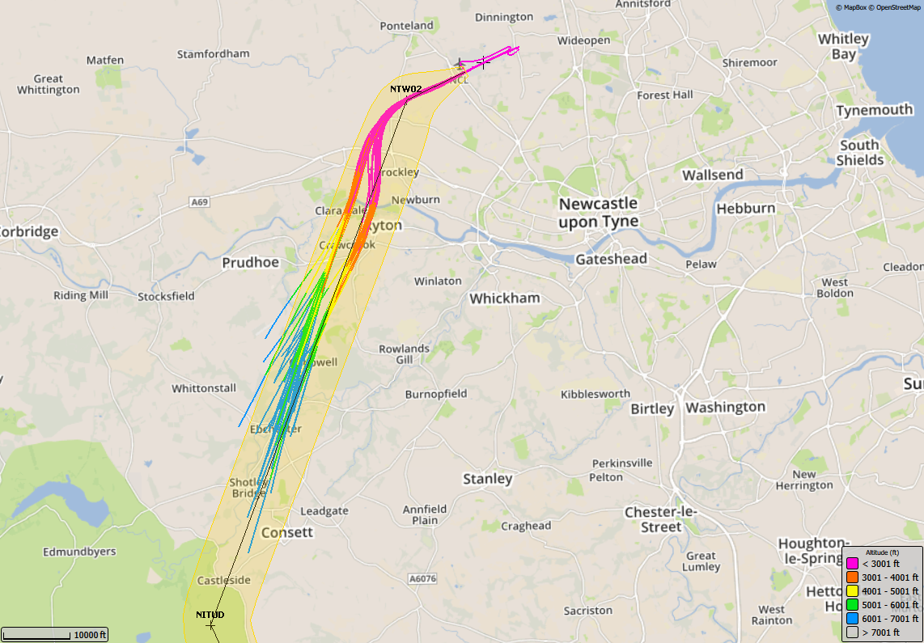
8/5/17 – 22/5/17, GIRLI 3X (111 TRACKS), Boeing 737-800

Slide 11
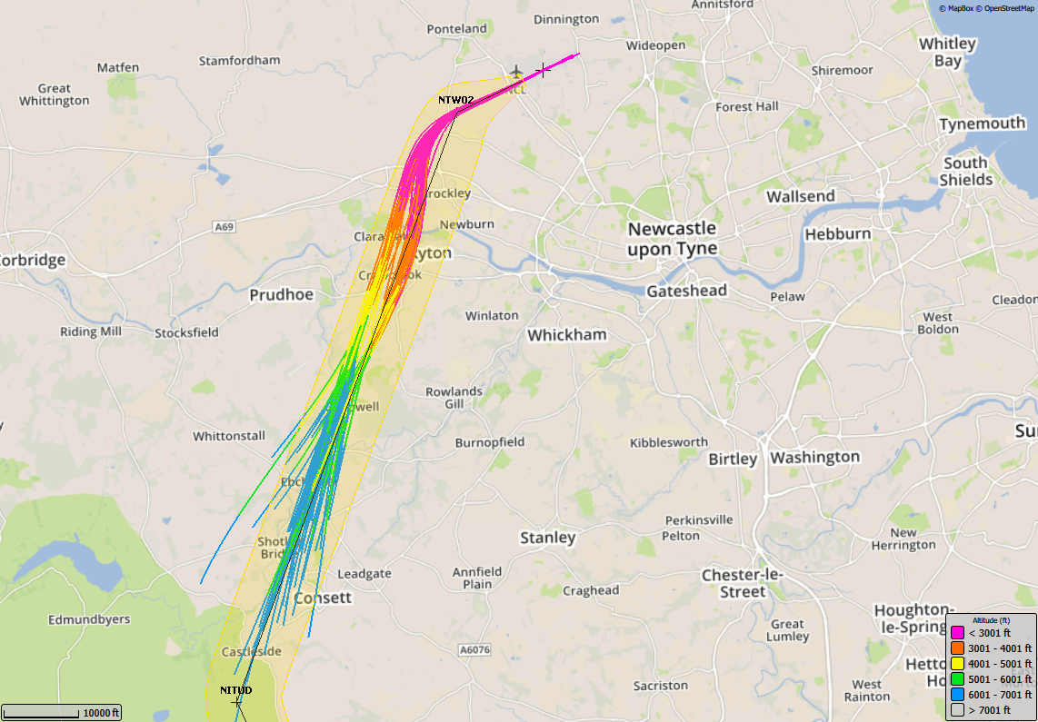
7/8/17 – 21/8/17, GIRLI 3X (189 TRACKS), Boeing 737-800

Slide 12
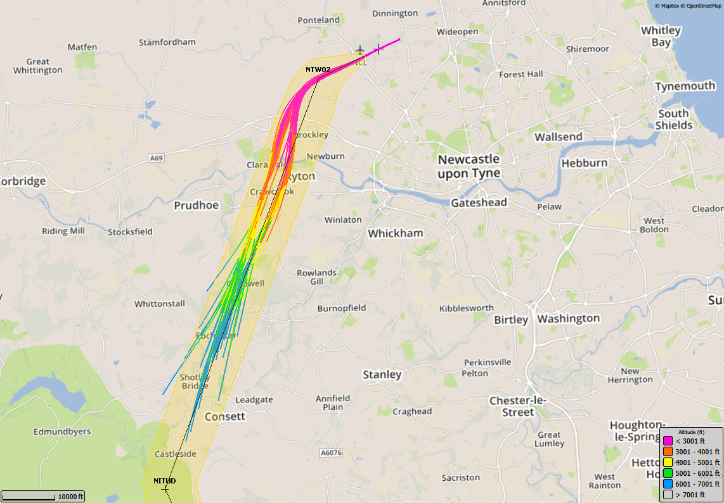
6/11/17 –20/11/17, GIRLI 3X (82 TRACKS), Boeing 737-800

Slide 13
5/2/18 – 19/2/18, GIRLI 3X (71 TRACKS), Boeing 737-800

Slide 14
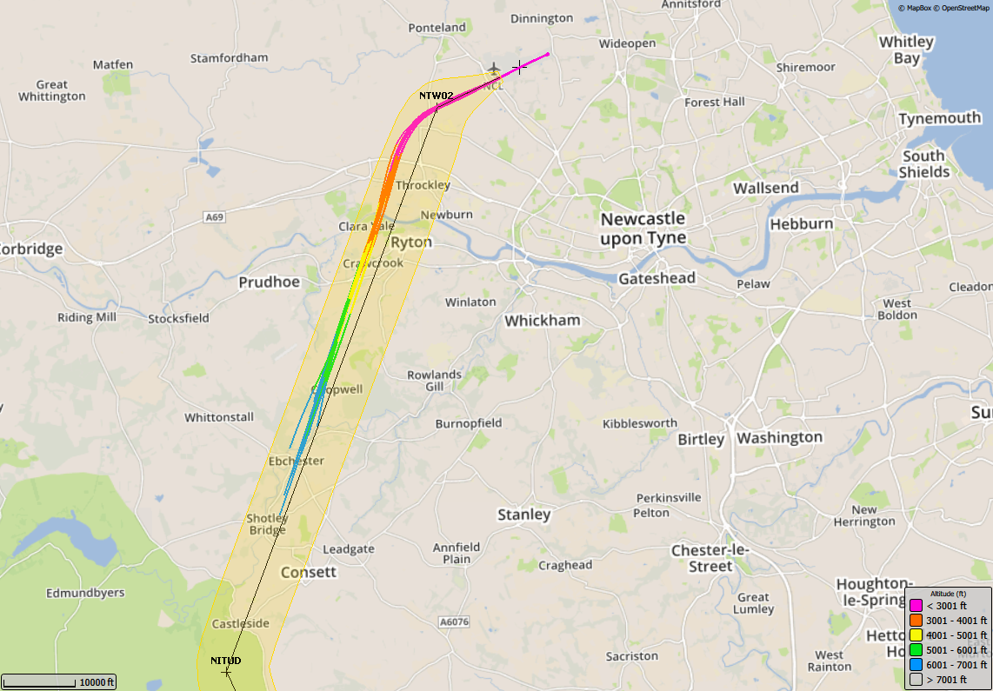
8/5/17 – 22/5/17, GIRLI 3X (23 TRACKS), Boeing 737-300

Slide 15
7/8/17 – 21/8/17, GIRLI 3X (51 TRACKS), Boeing 737-300

Slide 16
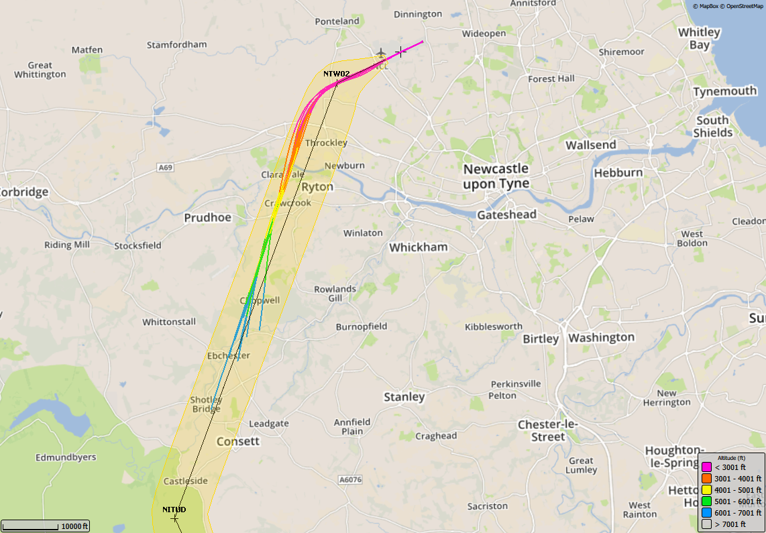
6/11/17 –20/11/17, GIRLI 3X (13 TRACKS), Boeing 737-300

Slide 17
5/2/18 – 19/2/18, GIRLI 3X (23 TRACKS), Airbus 321

Slide 18
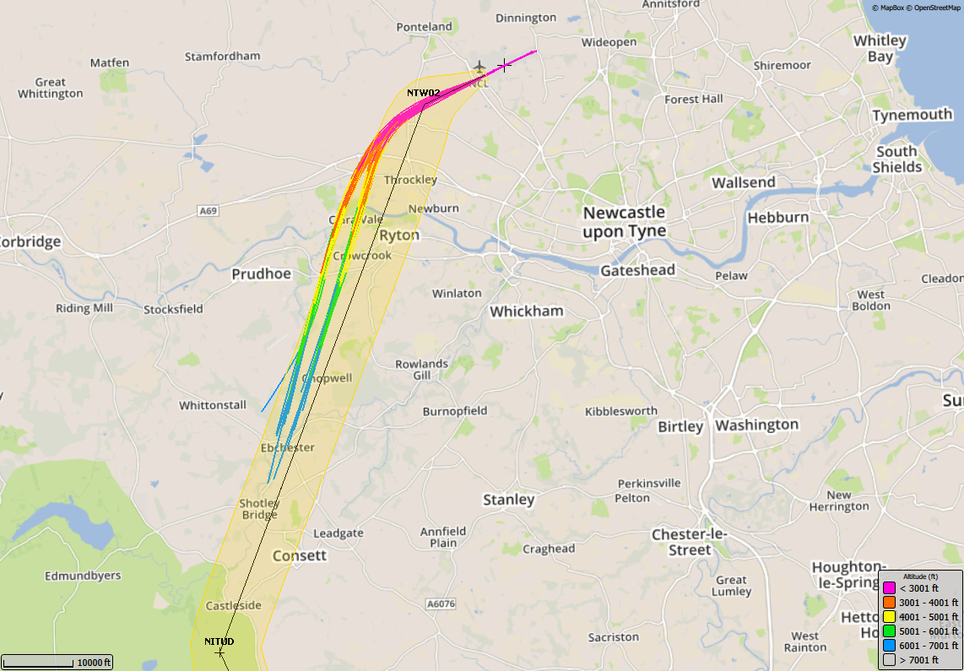
8/5/17 – 22/5/17, GIRLI 3X (29 TRACKS), Dash 8 Delta

Slide 19
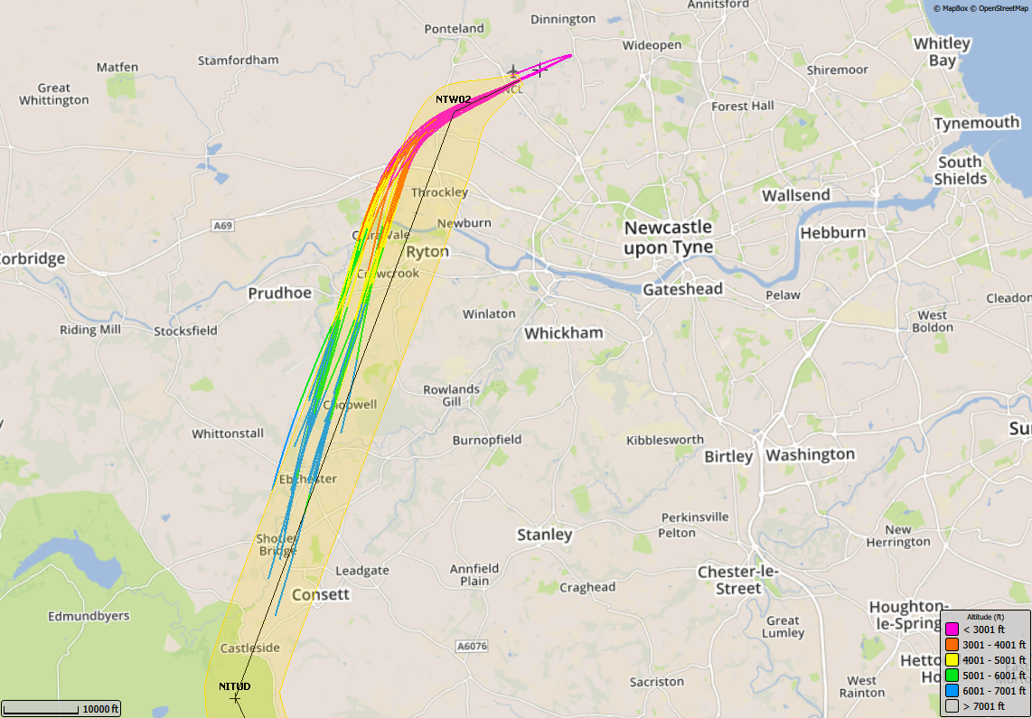
7/8/17 – 21/8/17, GIRLI 3X (45 TRACKS), Dash 8 Delta

Slide 20
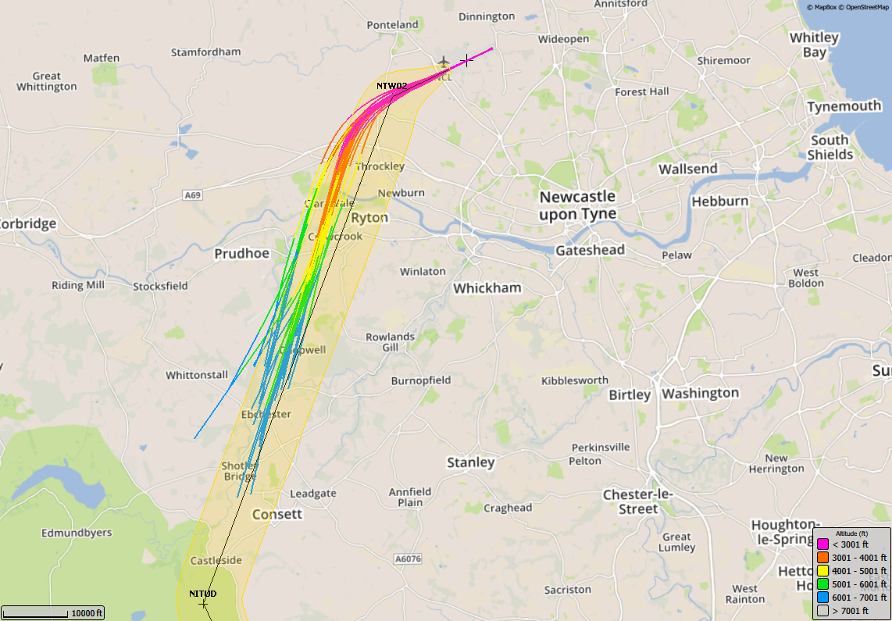
6/11/17 –20/11/17, GIRLI 3X (42 TRACKS), Dash 8 Delta

Slide 21
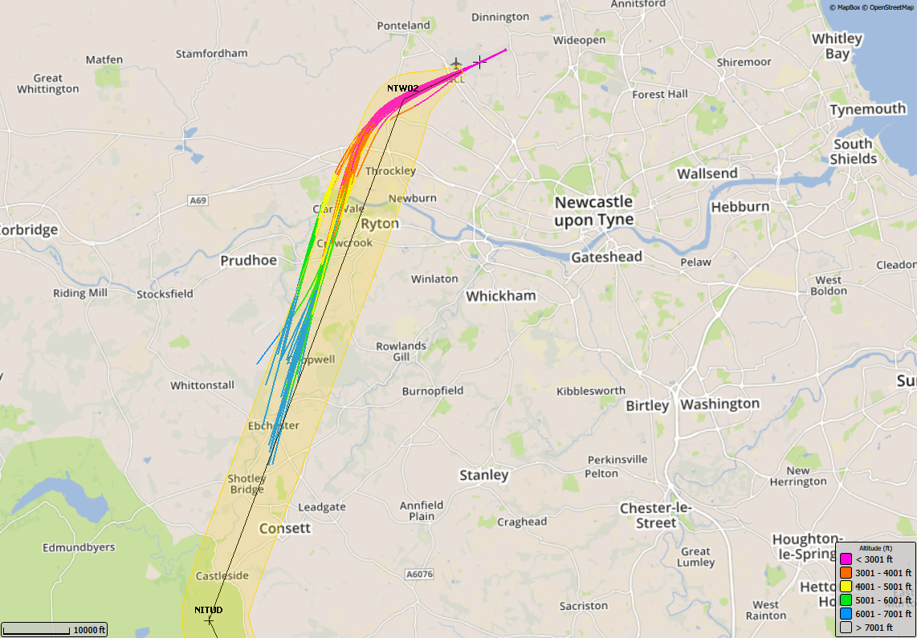
5/2/18 – 19/2/18, GIRLI 3X (44 TRACKS), Dash 8 Delta

Slide 22
2017&2018 – Track Plots by Aircraft Type
GIRLI 1Y

Slide 23
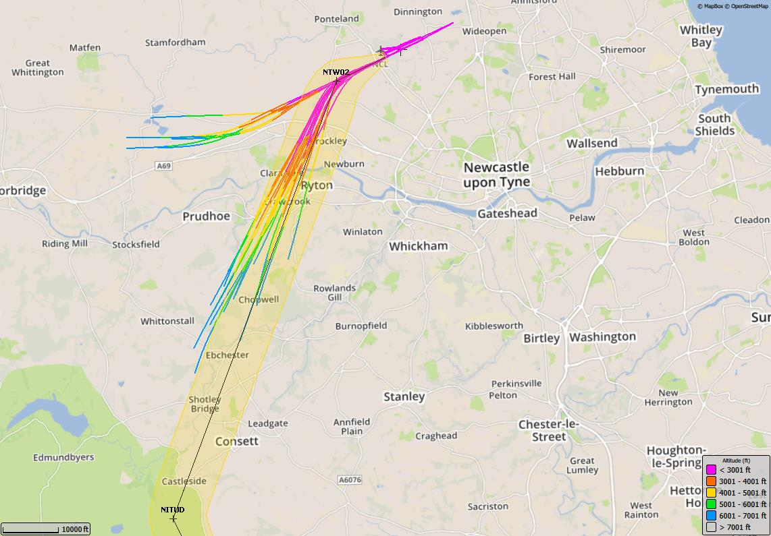
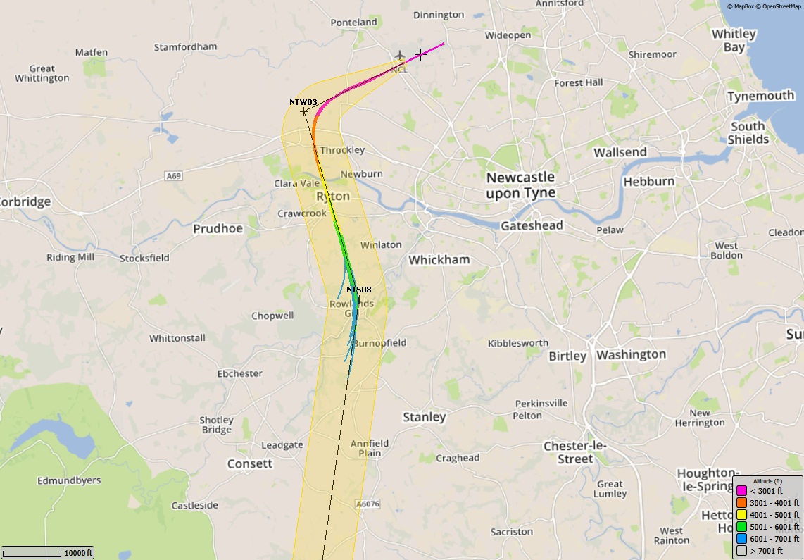
8/5/17 – 22/5/17, GIRLI 1Y (11 TRACKS), Airbus 319

Slide 24
7/8/17 – 21/8/17, GIRLI 1Y (9 TRACKS), Airbus 319

Slide 25
6/11/17 –20/11/17, GIRLI 1Y (6 TRACKS), Airbus 319

Slide 26
5/2/18 – 19/2/18, GIRLI 1Y (19 TRACKS), Airbus 319

Slide 27
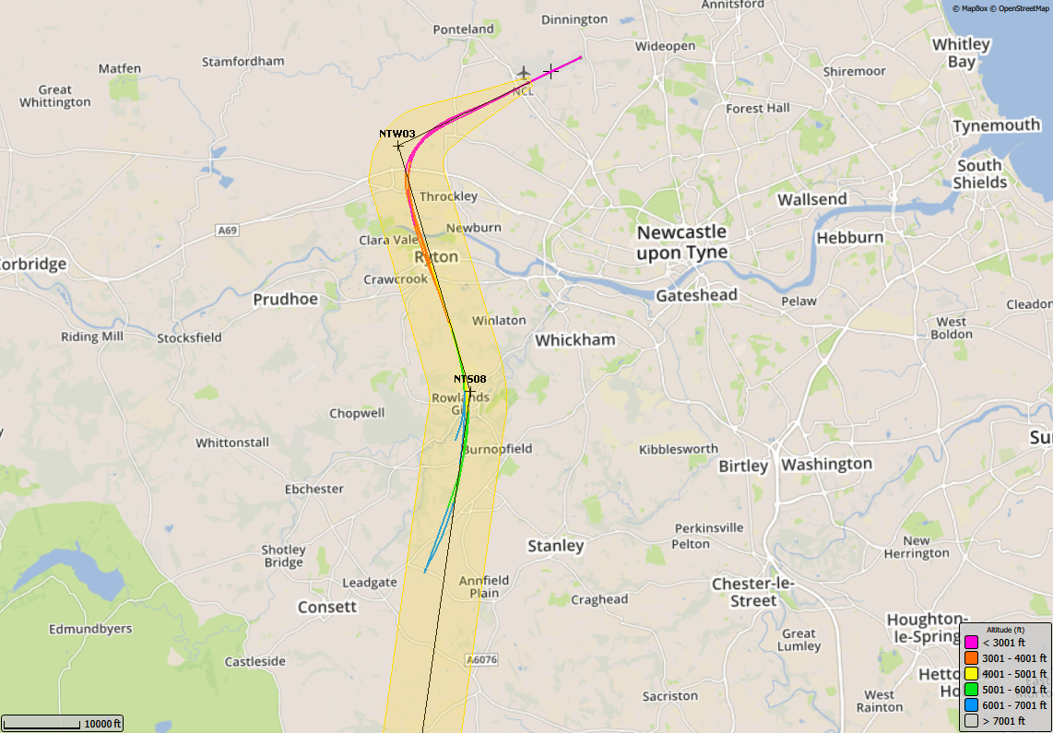
8/5/17 – 22/5/17, GIRLI 1Y (4 TRACKS), Airbus 320

Slide 28
7/8/17 – 21/8/17, GIRLI 1Y (2 TRACKS), Airbus 320

Slide 29
6/11/17 –20/11/17, GIRLI 1Y (3 TRACKS), Airbus 320

Slide 30
5/2/18 – 19/2/18, GIRLI 1Y (0 TRACKS), Airbus 320

Slide 31
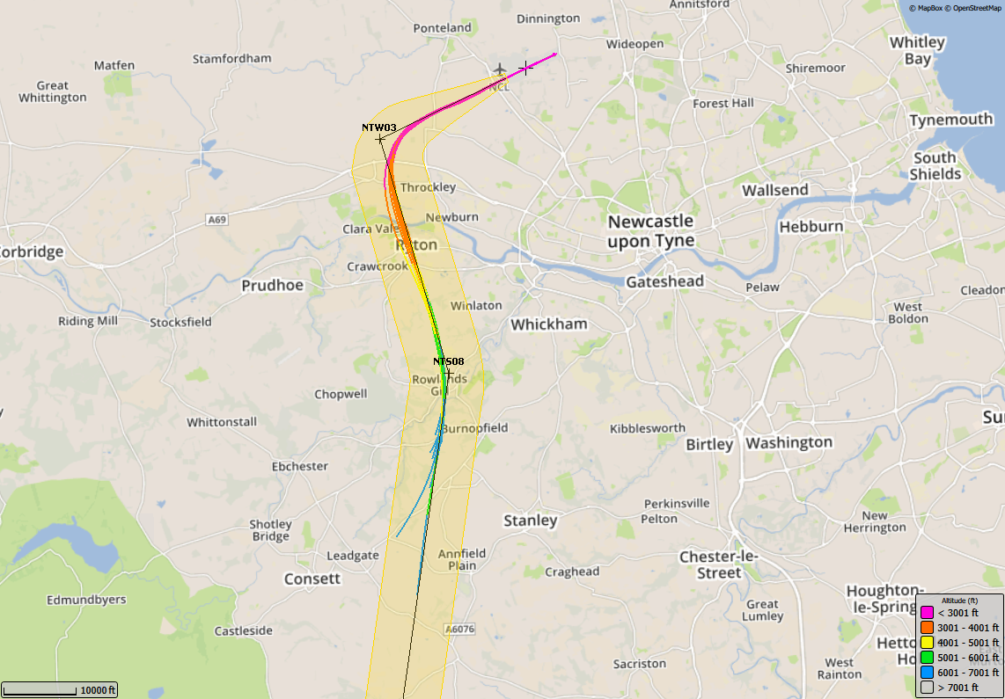
8/5/17 – 22/5/17, GIRLI 1Y (17 TRACKS), Boeing 737-800

Slide 32
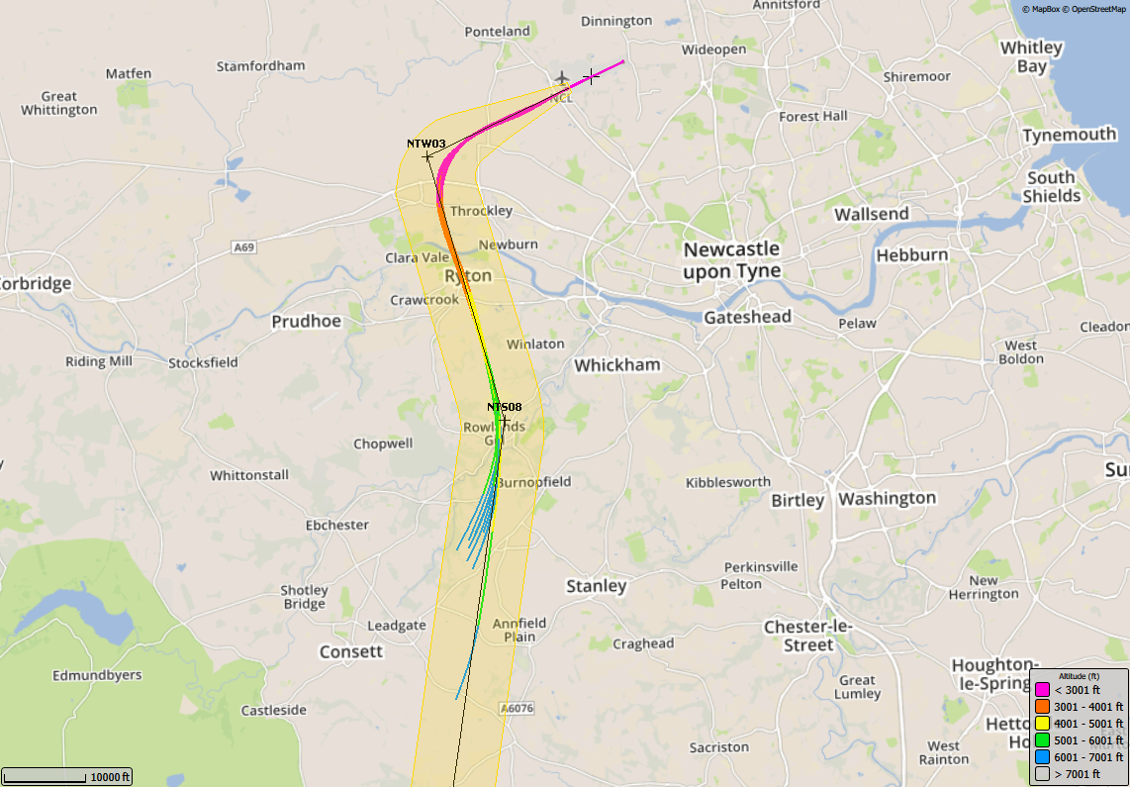
7/8/17 – 21/8/17, GIRLI 1Y (11 TRACKS), Boeing 737-800

Slide 33
6/11/17 –20/11/17, GIRLI 1Y (6 TRACKS), Boeing 737-800

Slide 34
5/2/18 – 19/2/18, GIRLI 1Y (5 TRACKS), Boeing 737-800

Slide 35
8/5/17 – 22/5/17, GIRLI 1Y (2 TRACKS), Boeing 737-300

Slide 36
7/8/17 – 21/8/17, GIRLI 1Y (4 TRACKS), Boeing 737-300

Slide 37
6/11/17 –20/11/17, GIRLI 1Y (3 TRACKS), Boeing 737-300

Slide 38
5/2/18 – 19/2/18, GIRLI 1Y (3 TRACKS), Airbus 321

Slide 39
8/5/17 – 22/5/17, GIRLI 1Y (5 TRACKS), Dash 8 Delta

Slide 40
7/8/17 – 21/8/17, GIRLI 1Y (1 TRACK), Dash 8 Delta

Slide 41
6/11/17 –20/11/17, GIRLI 1Y (2 TRACKS), Dash 8 Delta

Slide 42
5/2/18 – 19/2/18, GIRLI 1Y (4 TRACKS), Dash 8 Delta

Slide 43
2017 & 2018 – Track Plots by Aircraft Type
GIRLI 1T

Slide 44
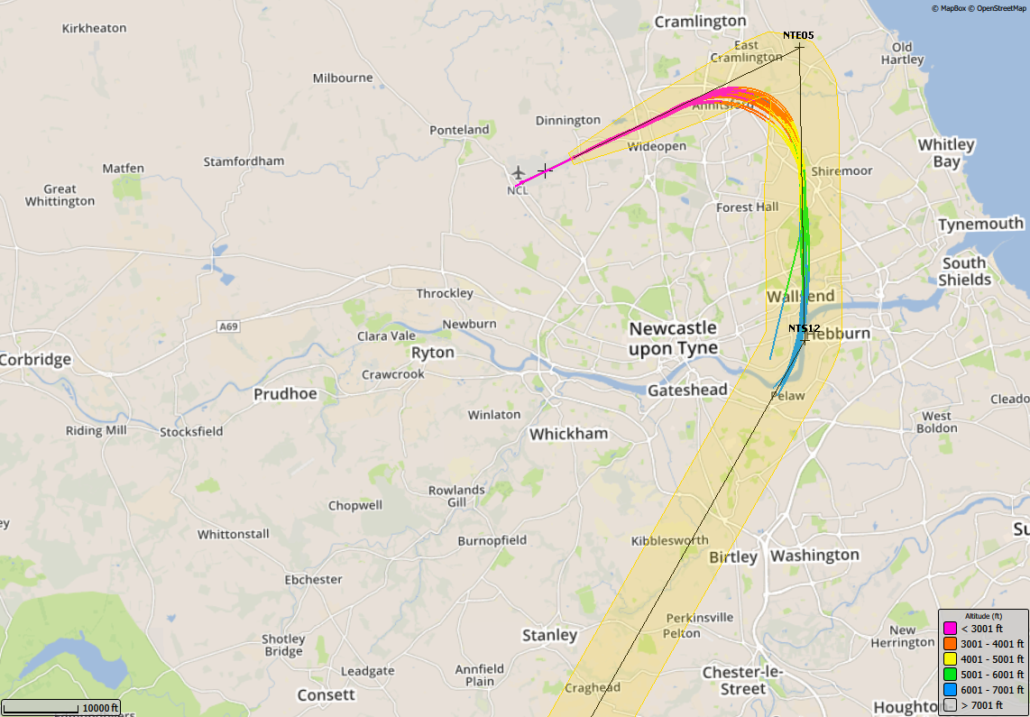
8/5/17 – 22/5/17, GIRLI 1T (42 TRACKS), Airbus 319

Slide 45
7/8/17 – 21/8/17, GIRLI 1T (21 TRACKS), Airbus 319

Slide 46
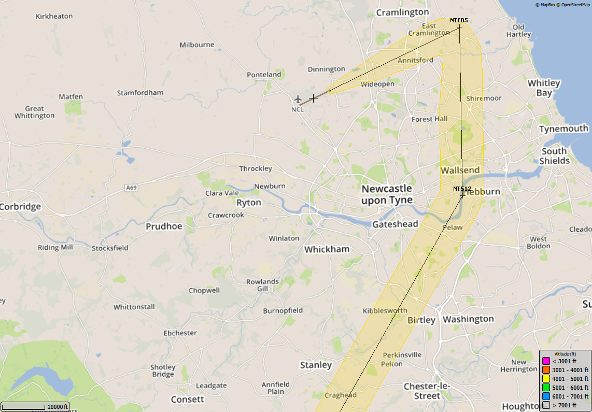
6/11/17 –20/11/17, GIRLI 1T (0 TRACKS), Airbus 319

Slide 47
5/2/18 – 19/2/18, GIRLI 1T (0 TRACKS), Airbus 319

Slide 48
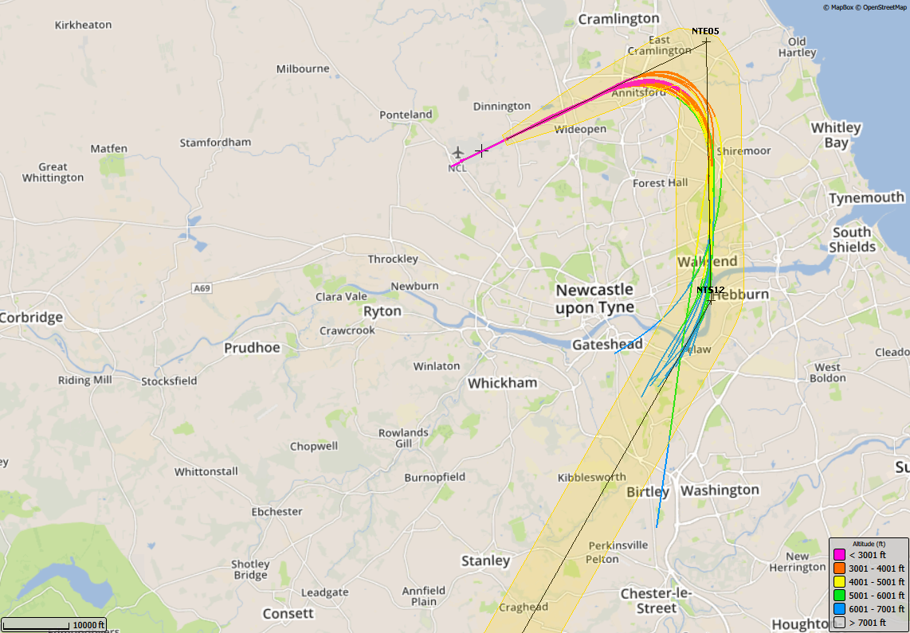
8/5/17 – 22/5/17, GIRLI 1T (24 TRACK), Airbus 320

Slide 49
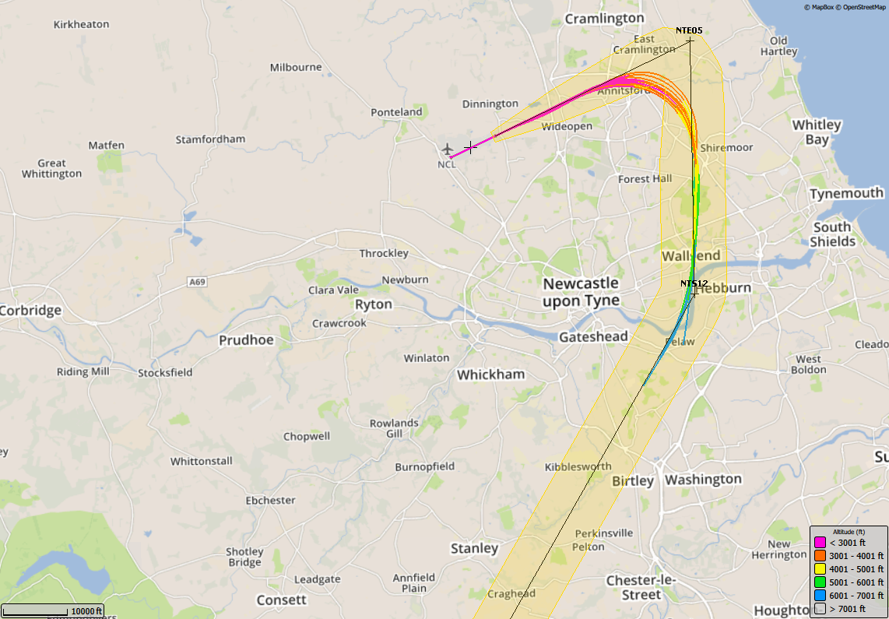
7/8/17 – 21/8/17, GIRLI 1T (13 TRACKS), Airbus 320

Slide 50
6/11/17 –20/11/17, GIRLI 1T (0 TRACKS), Airbus 320

Slide 51
5/2/18 – 19/2/18, GIRLI 1T (1 TRACK), Airbus 320

Slide 52
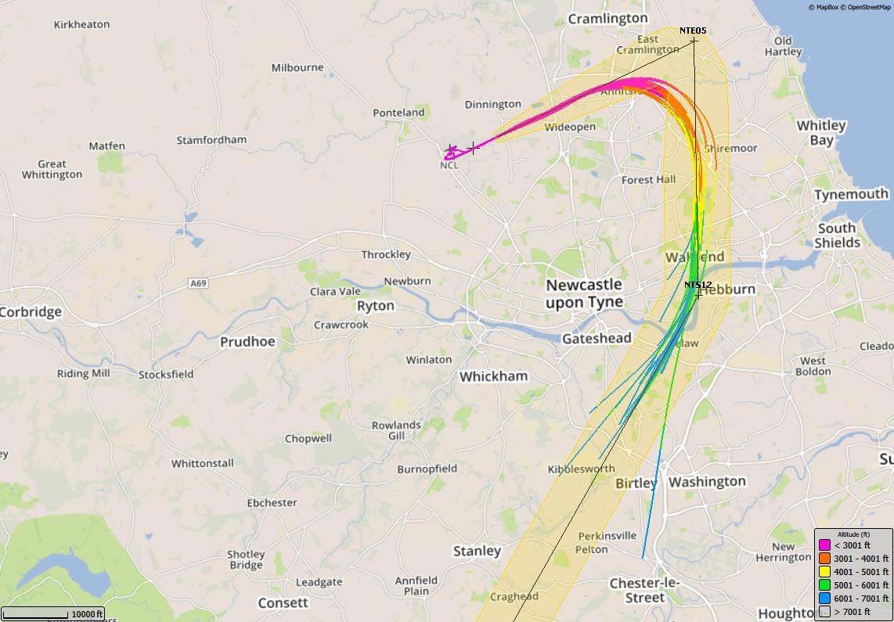
8/5/17 – 22/5/17, GIRLI 1T (61 TRACKS), Boeing 737-800

Slide 53
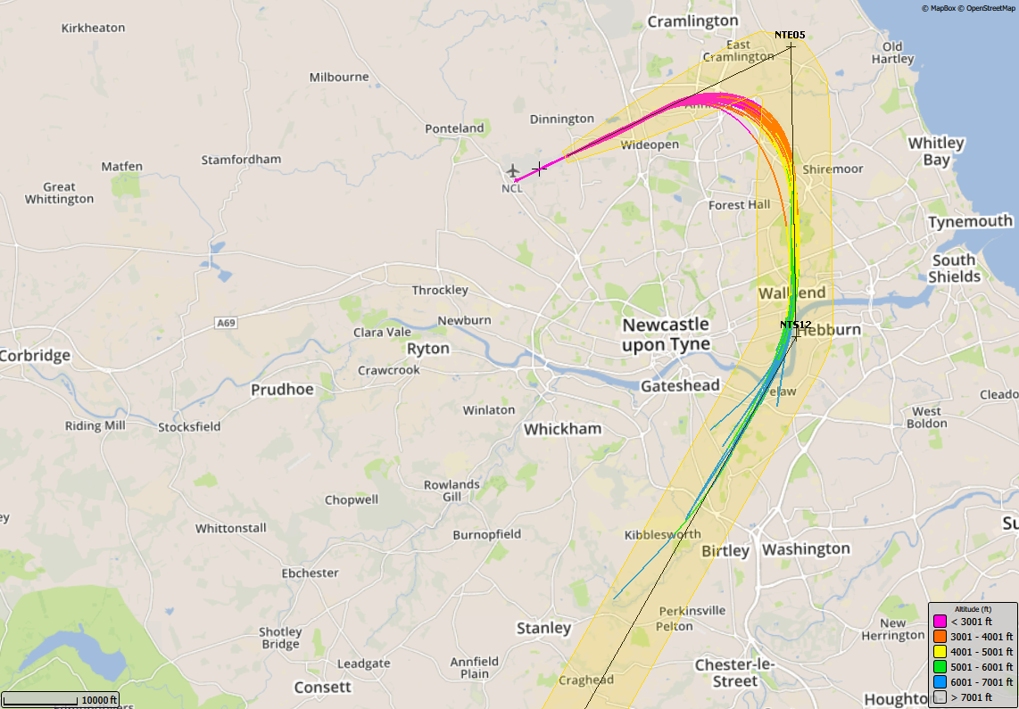
7/8/17 – 21/8/17, GIRLI 1T (33 TRACKS), Boeing 737-800

Slide 54
6/11/17 –20/11/17, GIRLI 1T (0 TRACKS), Boeing 737-800

Slide 55
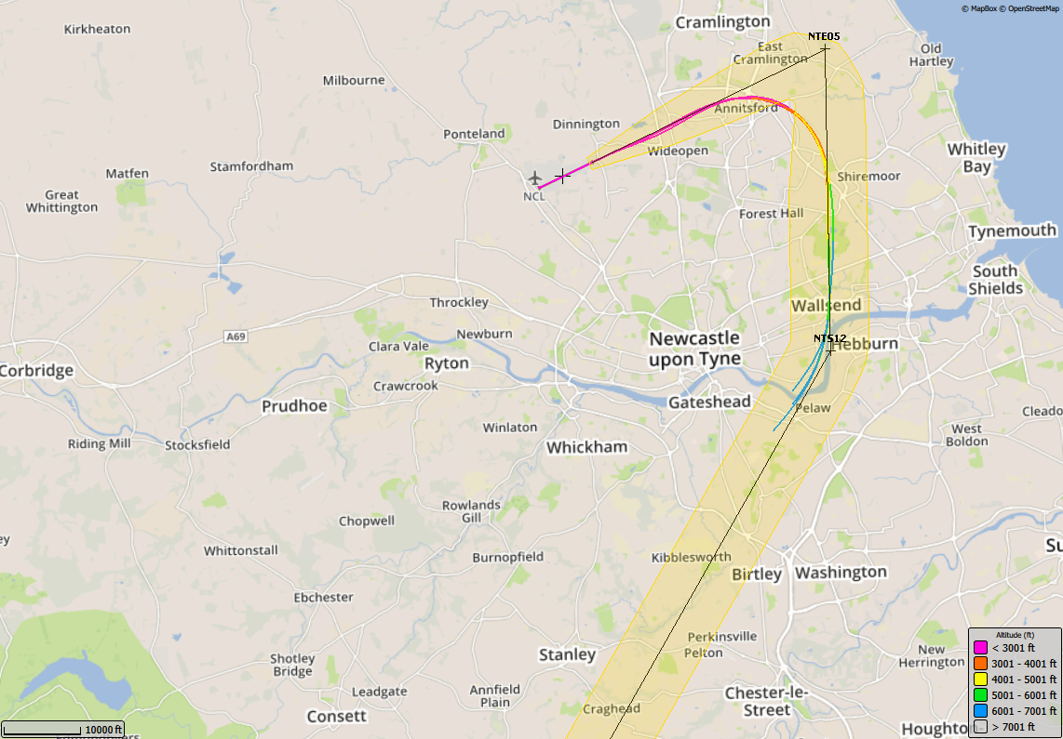
5/2/18 – 19/2/18, GIRLI 1T (4 TRACKS), Boeing 737-800

Slide 56
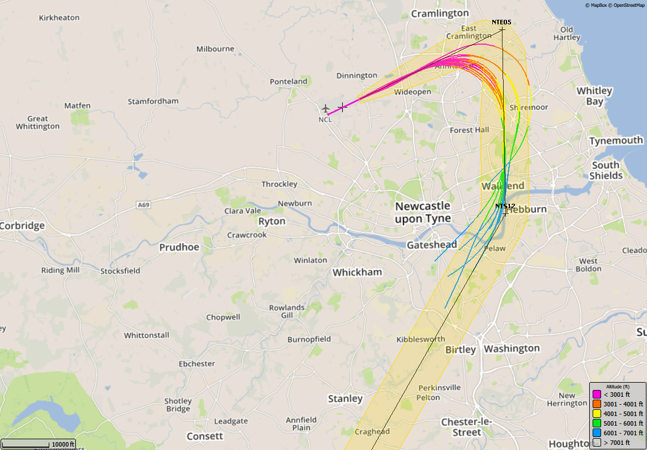
8/5/17 – 22/5/17, GIRLI 1T (15 TRACKS), Boeing 737-300

Slide 57
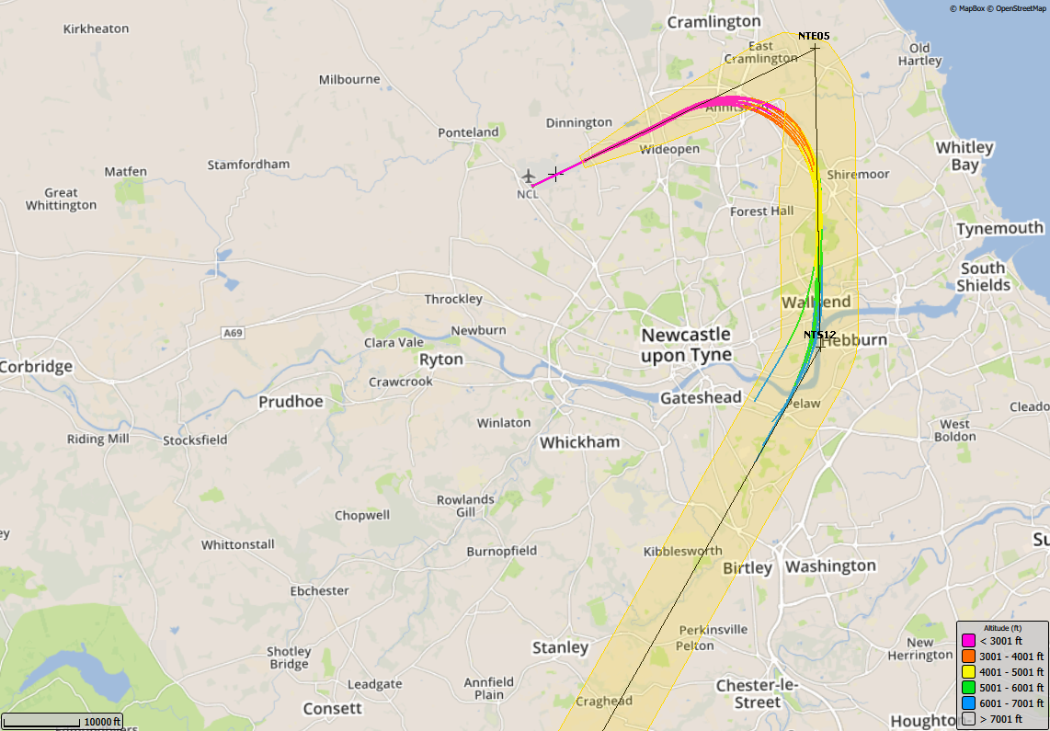
7/8/17 – 21/8/17, GIRLI 1T (11 TRACKS), Boeing 737-300

Slide 58
6/11/17 –20/11/17, GIRLI 1T (0 TRACKS), Boeing 737-300

Slide 59
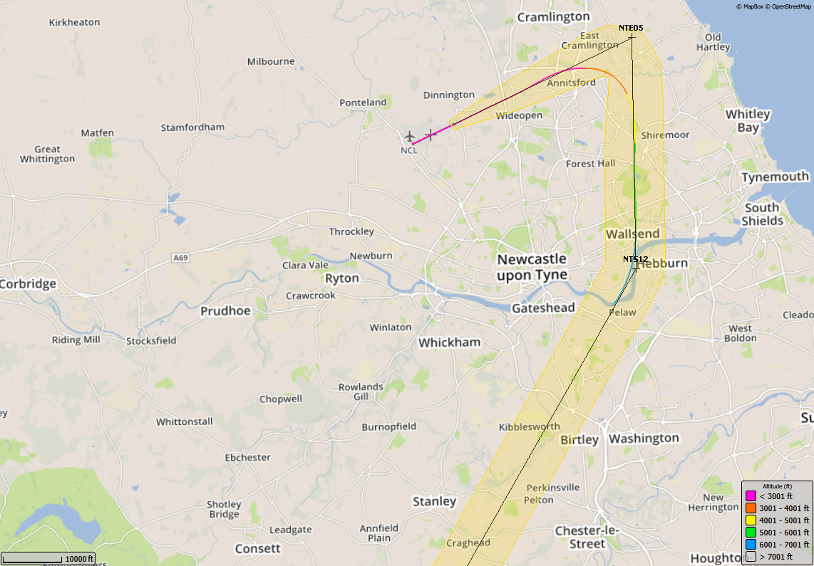
5/2/18 – 19/2/18, GIRLI 1T (1 TRACK), Airbus 321

Slide 60
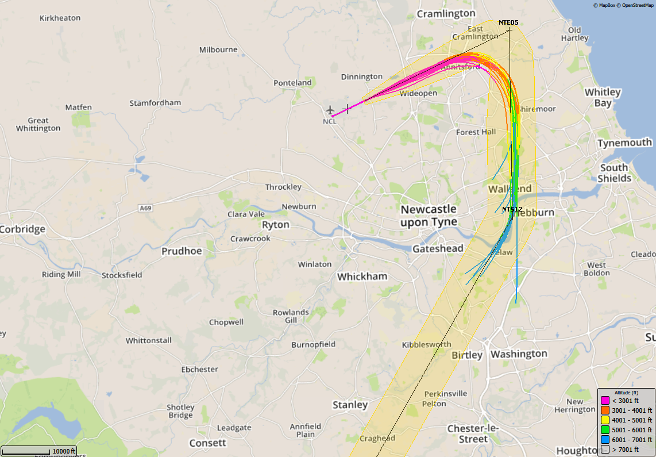
8/5/17 – 22/5/17, GIRLI 1T (26 TRACKS), Dash 8 Delta

Slide 61
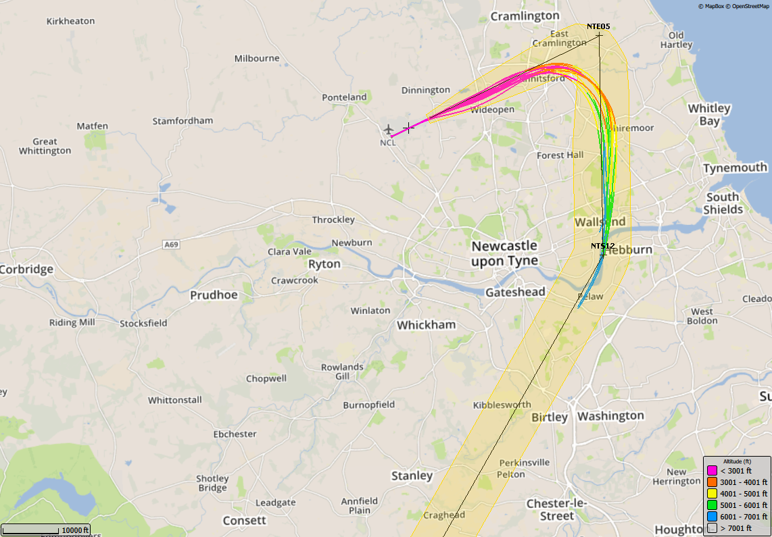
7/8/17 – 21/8/17, GIRLI 1T (11 TRACKS), Dash 8 Delta

Slide 62
6/11/17 –20/11/17, GIRLI 1T (0 TRACKS), Dash 8 Delta

Slide 63
5/2/18 – 19/2/18, GIRLI 1T (1 TRACK), Dash 8 Delta

