Slide 1
General Aviation Unit Stakeholder Update
June 2023

Slide 2
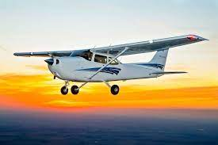
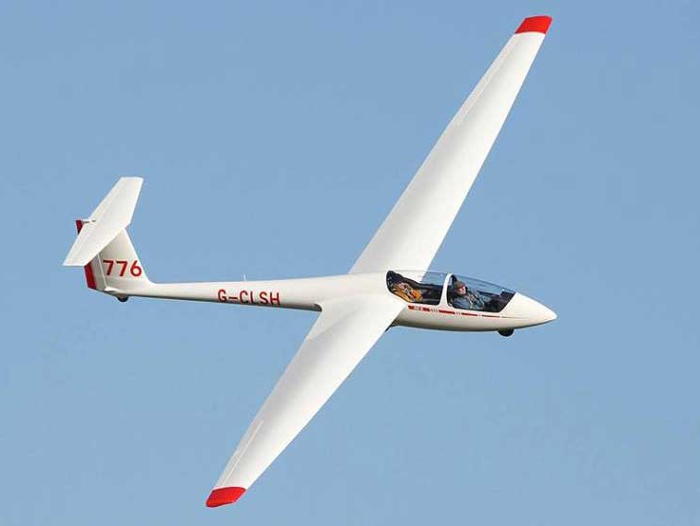
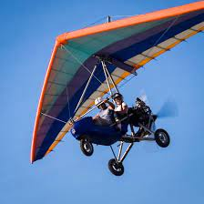

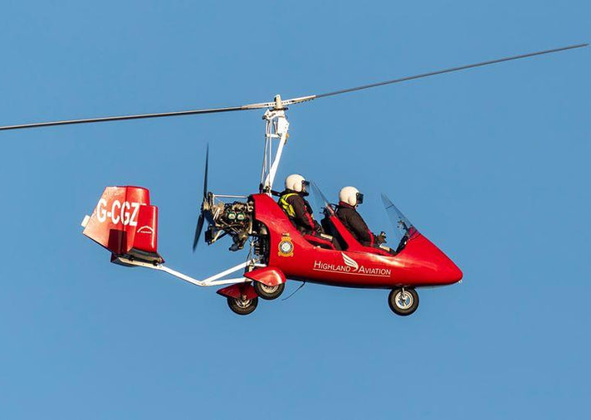
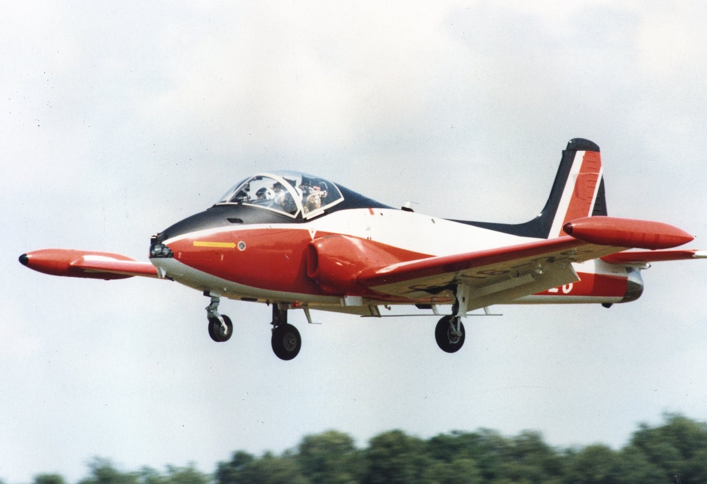
Introduction to the GA Unit:
Our General Aviation Unit was formed in 2014 and is dedicated to effective regulation that supports and encourages a dynamic GA sector.
We regulate non complex aircraft including microlights, amateur built and historic aircraft, balloons, gliders, piston twins and singles up to 5,700kg maximum take off weight and single pilot helicopters up to 3,175kg.

Slide 3


How the GA Change Programme Started:
We asked 10 specific questions to help us better understand:
  how we could help the GA community (and its associated businesses and industries) to flourish after leaving EASA, and to identify its specific priorities;
  how we could engage with and work more efficiently, constructively and collaboratively with the GA communities in delivering our objectives.
  Consultation resulted in:
  3 strategic projects
  15 tactical projects
  16 “Quick Win” activities
  12 changes to “Ways of Working”

Slide 4





Key Projects Delivered to Date:
Introduced Skyway Code and Skyway Code for Airworthiness
Published updated BCAR Section S
Delegation of licensing to the British Gliding Association
Creation of Safety Standards Acknowledgements and Consent Class 5 (Fast Jets)
Completed a comparison study with other NAAs’ practices

Slide 5




Key Projects Delivered to Date:
Implemented E-Exams for Part 66L and BFCL licenses
Allow UK Part 21 aircraft to be flown on a national licence
Revert to previous rules for Visibility and Distance from Cloud Minima for flying in VMC
Appointed a CAA GA ‘just culture’ champion

Slide 6
Scope of the 2023/24 Programme
DfT funding from the previous two financial years reduced by 25%
CAA re-defined it’s project scope to match the revised financial resource
Some flexibility built into the portfolio to introduce or reduce the scope of projects subject to change control approval
Project Title | Summary Description
Licensing & Training Simplification (L&TS) Project | Continuation of the simplification and rationalisation of Flight Crew Licensing and Training
Airworthiness Simplification | Continuation of simplification and rationalisation of Airworthiness guidance material
Pilot Medical Declaration (PMD) | Continuation of the review of Pilot Medical Declaration (PMD) process
Greening GA | Exploration of opportunities to implement guidance or policy which supports greener technologies in the GA Sector, incorporating T2 (Airfield Innovation) and T4 (Innovation in Power & Fuels)
Self-Propelled Hang Gliders (SPHG) Project | To review existing guidance and regulations applicable to sub-70kg aircraft and determine whether current guidance and levels of oversight for this class of aircraft are sufficient.
BCAR "A" Refresh | Broader review and update of BCAR Section’s (A8-26, A3-7, A8- 23, 24, 25)
Safety Sense Leaflets (including Skyway Code refresh) | Ongoing review, refresh and development of the Safety Sense Leaflet Library and an updated edition of the Skyway Code
BCAR Section S | Review and update of British Civil Aviation Regulation (BCAR) Section S in consultation with GA Sector Stakeholders – Completed
CODE | Publication of CO Trial findings and follow-up policy review.
e-Conditions | Joint (CAA & RAeS) review of CAP 1220 and AAIB Safety Recommendation response to G-HIZA accident

Slide 7
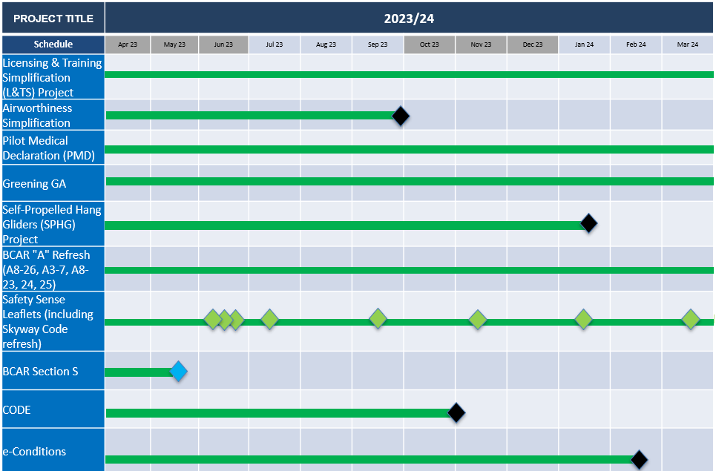
GA Programme Major Milestones 2023/24

Slide 8
Planning Considerations
        A broader CAA SARG reorganisation is in progress with the creation of a Future Safety and Innovation business area.
        Some projects may require Impact assessment to support the rulemaking process. This is a capability which remains immature and the CAA relies on support from the DfT currently.
        GA Programme projects are dependent largely on GA Unit resource. This work is in addition to their operational roles which can be subject to unforeseen demands, typically safety related.

Slide 9
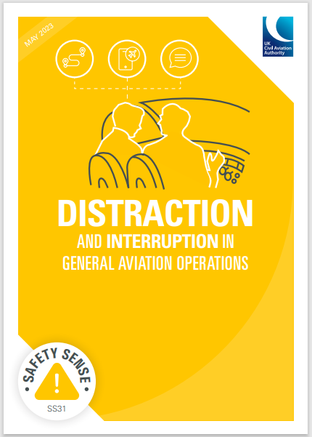
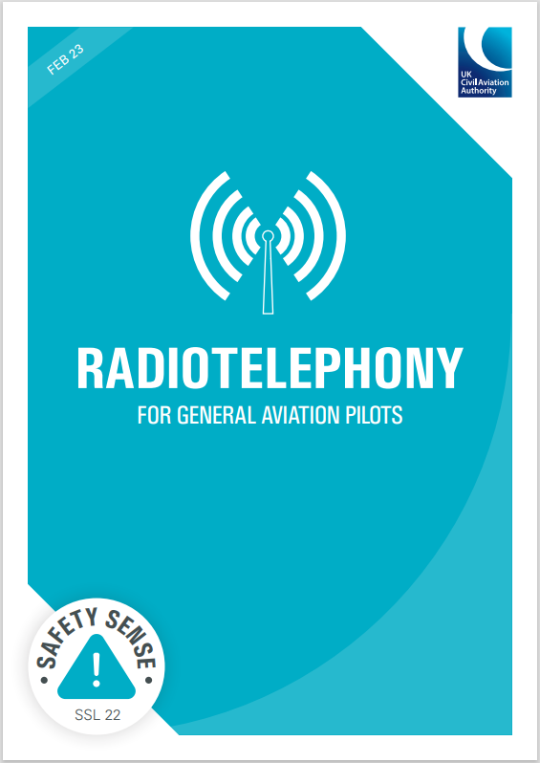

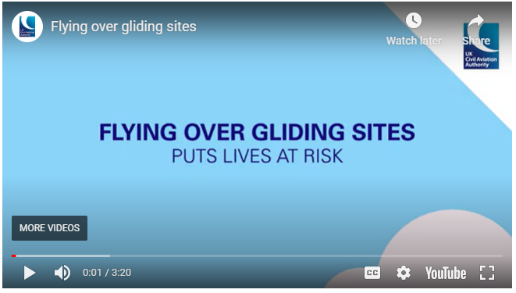
Recent Safety Publications:
Safety Sense Leaflets – Radiotelephony & Distraction
‘Go, or no go?’ our latest Clued Up article on rejected takeoffs
Animation on operating near gliding sites
New podcast episodes with the LAA and CAA’s Met Technical Officer
Just Culture occurrence reports
Keep up to date on new content via our
website and social media pages (LinkedIn, Twitter, Youtube).

Slide 10
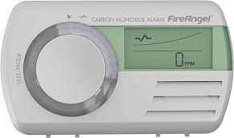

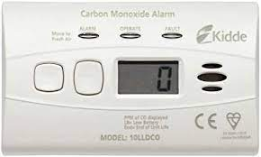
Active Co Detectors – have your say
Survey launched – we want to hear from you! (whether you use an active detector or not)
Feedback will help us shape the future use of these devices in the GA environment.
https://www.surveymonkey.co.uk/r/BL75XDJ

Slide 11

Sign Up to Skywise – its FREE!
Skywise is the best source of tailored alerts on:
new guidance (such as publications and web updates)
restricted airspace
changes to rules and regulations
consultations
upcoming events
Go to https://skywise.caa.co.uk/home or search ‘CAA Skywise’

Slide 12
Questions?

